Slide 1


Slide 2



Student Gradebook
STUDENT MODE
P.I.L.A
TEACHER MODE
PACRES INTEGRATED LEARNING APPLICATION

Slide 3





Student Gradebook
STUDENT MODE
TEACHER MODE

Slide 5
PROJECT DESCRIPTION
Quiz games
Reading level tracker
Assist student’s learning
Progress manager
Help teachers manage student’s grades and performance

Slide 6
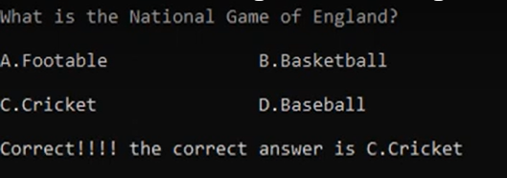
PROJECT DESCRIPTION
FEATURES:
Assist student’s learning
Quiz games
Reading level tracker
Help teachers manage student’s grades and performance
Progress manager

Slide 7
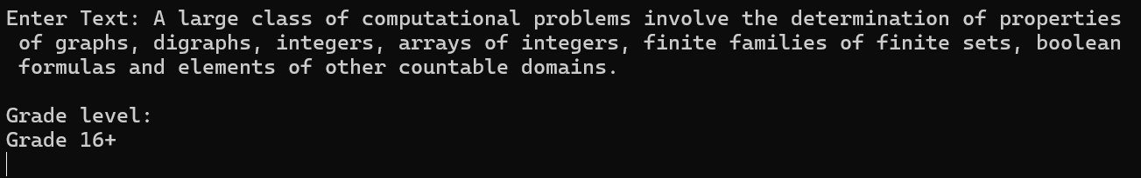
PROJECT DESCRIPTION
FEATURES:
Assist student’s learning
Quiz games
Help teachers manage student’s grades and performance
Reading level tracker
Progress manager

Slide 8
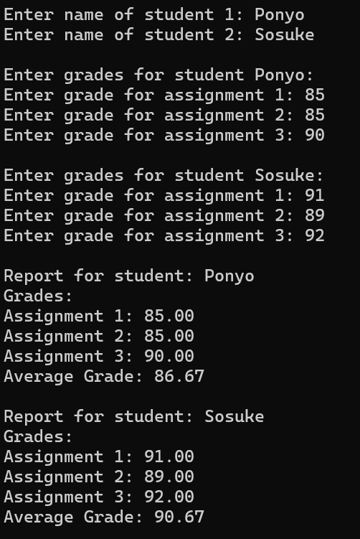
PROJECT DESCRIPTION
FEATURES:
Assist student’s learning
Reading level tracker
Help teachers manage student’s grades and performance
Quiz games
Progress manager

Slide 9
PROJECT DESCRIPTION
FEATURES:
Assist student’s learning
Progress manager
Help teachers manage student’s grades and performance
Quiz games
Reading level tracker

Slide 10
TECHNICAL DETAILS
Concepts Utilized:
Functions
Arrays
Pointers
Dynamic Memory Allocation
Structures
Implementation Plan:
Design UI
Implement functions and structures
Use arrays to store info
Use pointers and DMA for memory management

Slide 11

TECHNICAL DETAILS
Implementation Plan:
Design UI
Implement functions and structures
Use arrays to store info
Use pointers and DMA for memory management
Concepts Utilized:
Functions
Arrays
Pointers
Dynamic Memory Allocation
Structures

Slide 12

TECHNICAL DETAILS
Challenges and solutions:
Implementation Plan:
Design UI
Implement functions
Use arrays to store info
Use pointers for memory management
Concepts Utilized:
Functions
Arrays
Pointers
Dynamic Memory Allocation

Slide 13
PROJECT SCOPE
Develop comprehensible interface
Implement quiz games
Design reading level calculator
File handling may not be implemented

Slide 14
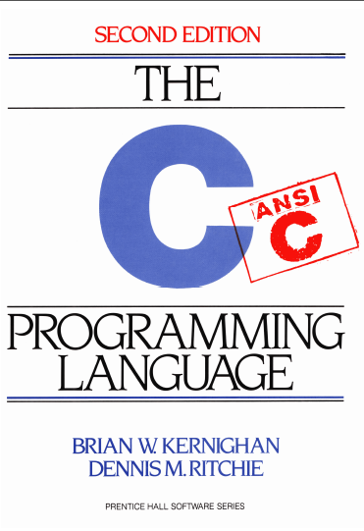







TIMELINE
May 3 – 10 – Coding
May 11 – 17 – Debugging
May 18 – 19 – Finalization
May 21 – Program presentation

Slide 15
RESOURCES

Slide 17
P.I.L.A
PACRES INTEGRATED LEARNING APPLICATION

